Slide 1




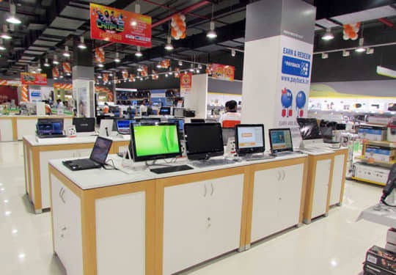
L . J . Institute of Engineering and Technology
Electronics
Store Management
Optimize Your Store, Maximize Your Profits.

Slide 2







Group Introduction
Dharmit Kakadiya
Rushvi Doshi
Shivangi
Gohel
Bhavesh
Velani
Roll no.:- 104
C.E.
Roll no.:- 109
C.E.
Roll no.:- 110
I.T.
Roll no.:- 113
I.T.
Enrollment
No. :-
23002170110059
23002170110037
23002170210034
23002170210134

Slide 3
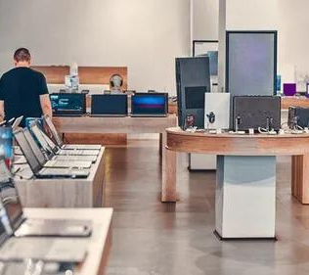

Project Outline
01
Purpose of project
07
Ds and Class Used
02
Project Overview
08
Procedure and Trigger
03
ER Diagram
09
Tools Used
04
Use case Diagram
10
Merits
05
Functionalities
11
Demerits
06
Implementation
12
References

Slide 4
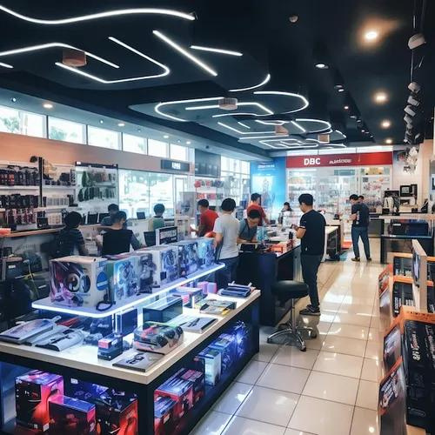
1
Purpose of project
Product Management
Inventory Management
Customer Management
Order and Billing

Slide 5
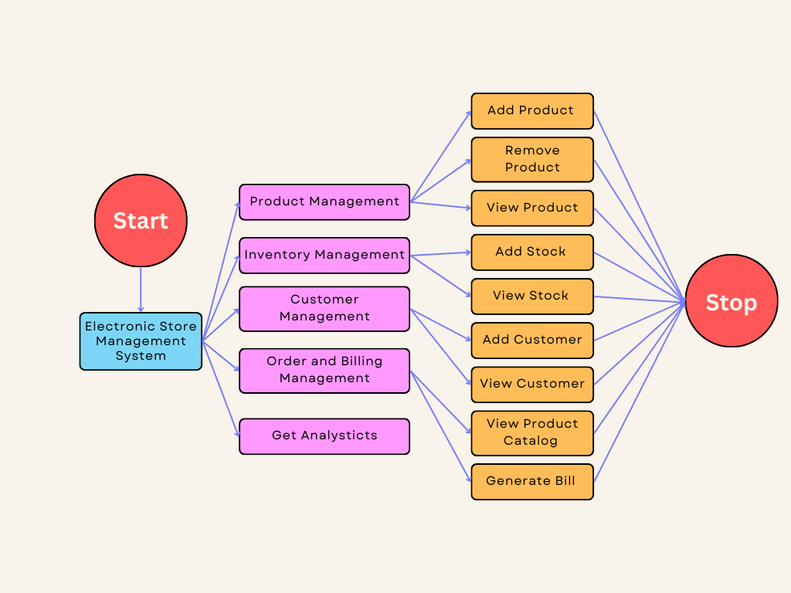
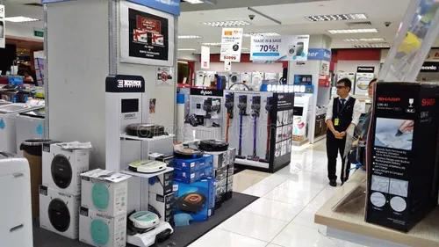
2
Project Overview

Slide 6
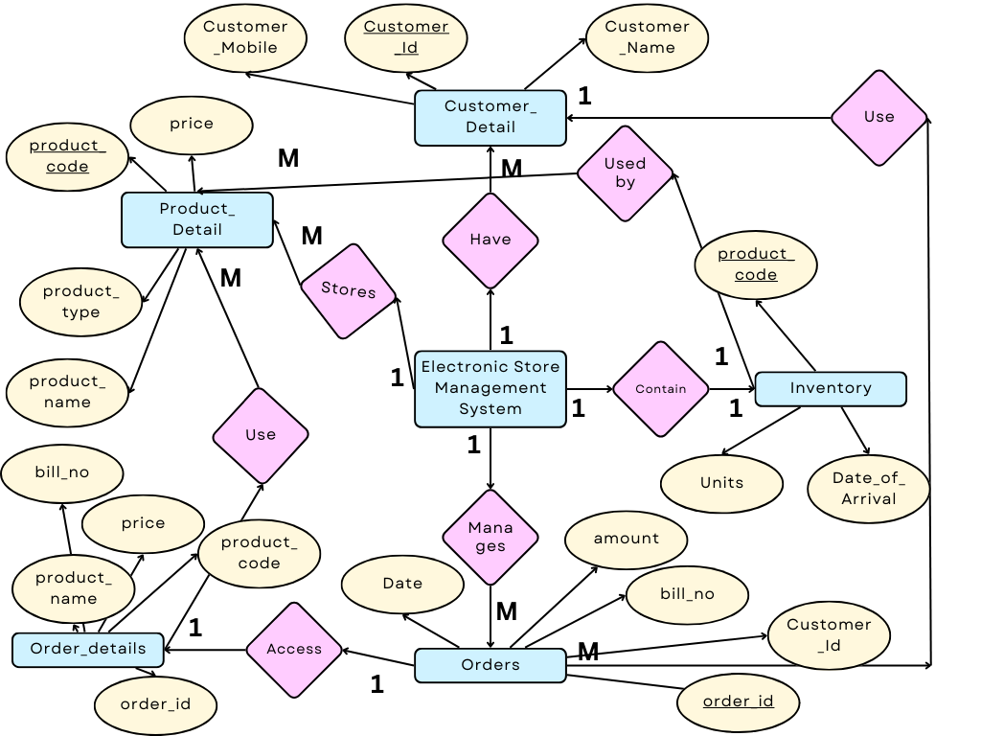
3
ER Diagram

Slide 7
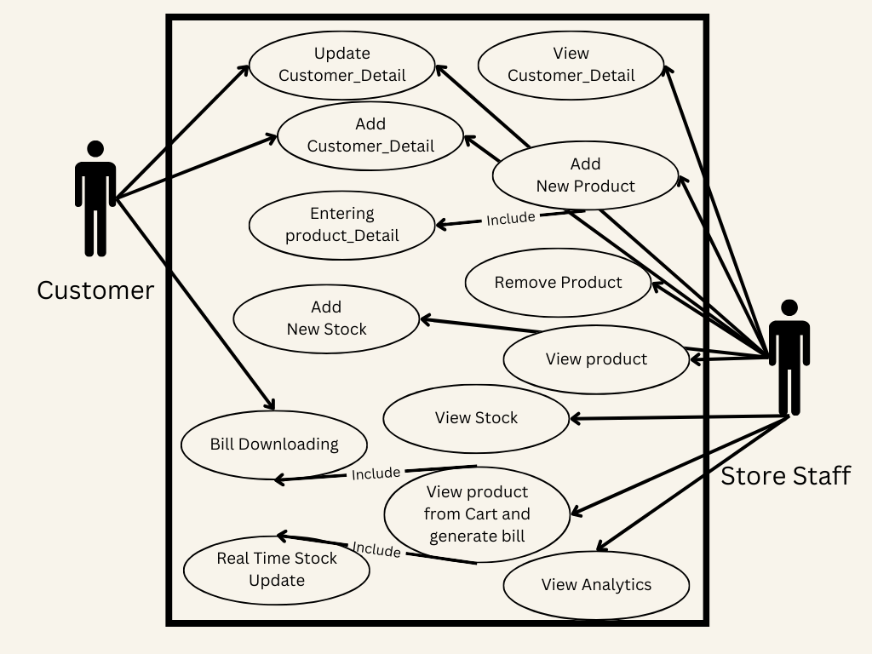
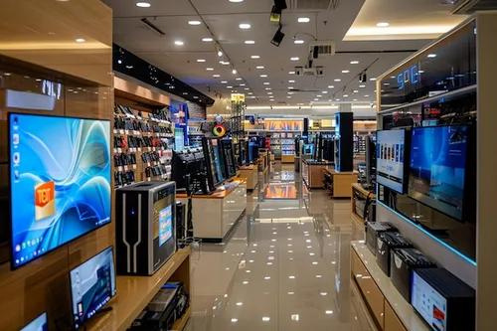
4
Usecase Diagram

Slide 8
5
Functionalities
Real Time Stock update
Stores Order History
Bill Downloading
Get Analysis
Manages Customer Details

Slide 9
6
Implementation
For DS -
1.Linked List
-Add
-Display
2.ArrayList
3.Priority Queue
For DBMS -
1.Procedure
2.Trigger
3.SubQueries
4.DBMS basics
For JAVA -
1.OOPs
2.File I/O
3.JDBC
4.Packages

Slide 10
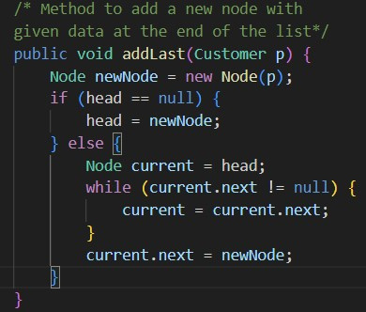
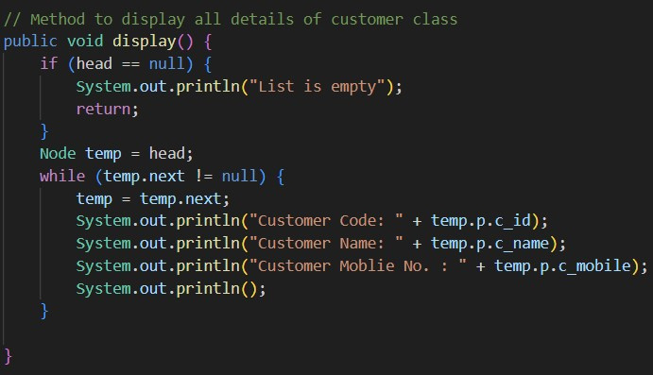
7
Ds and Class used
LinkedList Used for Customer Class
Insert Node
Display details
ArrayList used for Order class
Priority Queue used for Product class

Slide 11
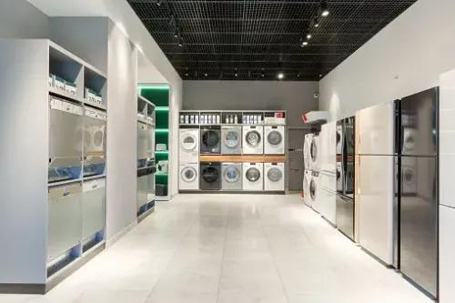
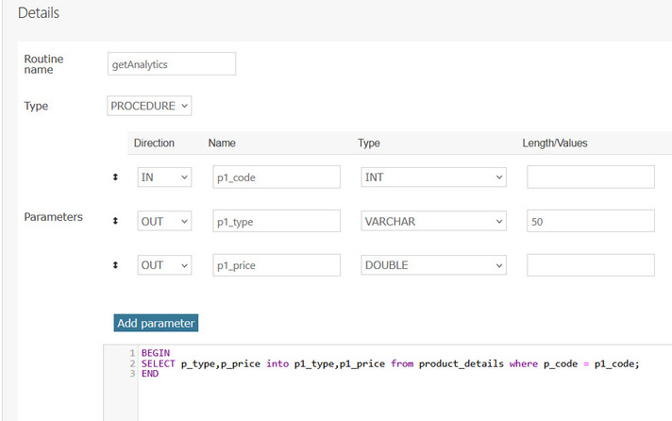
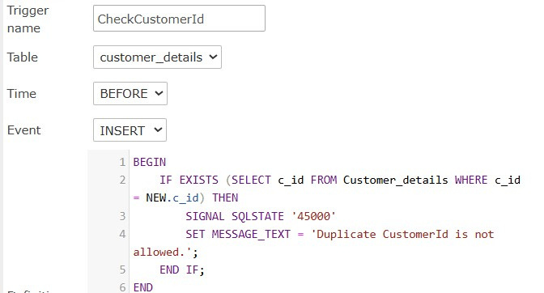
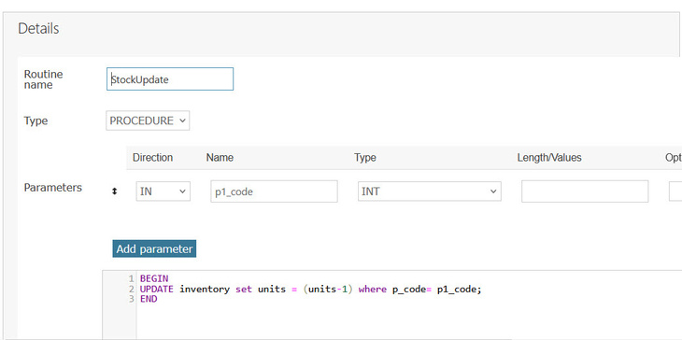

8
Procedures and Trigger
getAnalytic
CheckCustomerId Trigger Function
StockUpdate
Trigger Message

Slide 12


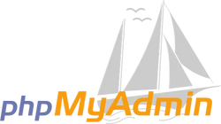

9
Tools used
Visual Code Studio
Xampp Control Panel
phpMyAdmin
Canva

Slide 13
10
Merits
Real-Time Tracking : Allows for real-time tracking of stock levels, helping prevent overstocking or stockouts.
Revenue Analysis : Provides detailed reports on sales, profits helping with budgeting and financial planning.
Operational Efficiency : Automates routine tasks such as billing, invoicing, and stock management, reducing manual effort and the risk of errors.

Slide 14
11
Demerits
System Downtime: Technical issues or system failures can disrupt store operations and affect sales and customer service.
Initial Investment: Setting up a store management system can involve significant upfront costs for software, hardware, and installation.
Software Upgrades: Updates to the software may be necessary to address bugs or add new features, which could require additional investment.

Slide 15
12
References
ChatGPT
Chrome
Faculties:
1.Parth Thakkar
2.Pooja Vyas
3.Divyang Patel

Slide 16

THANK YOU
From Our Group Members

